Slide 1


INSTRUMENT LEARNING AND KNOWLEDGE BY STRUCTURAL VISUAL INTERFACE
Java project(CSE 310)
NAME: ABHISHEK KUMAR SINGH
ROLL NO. 42
REG. NO. 12114530

Slide 2
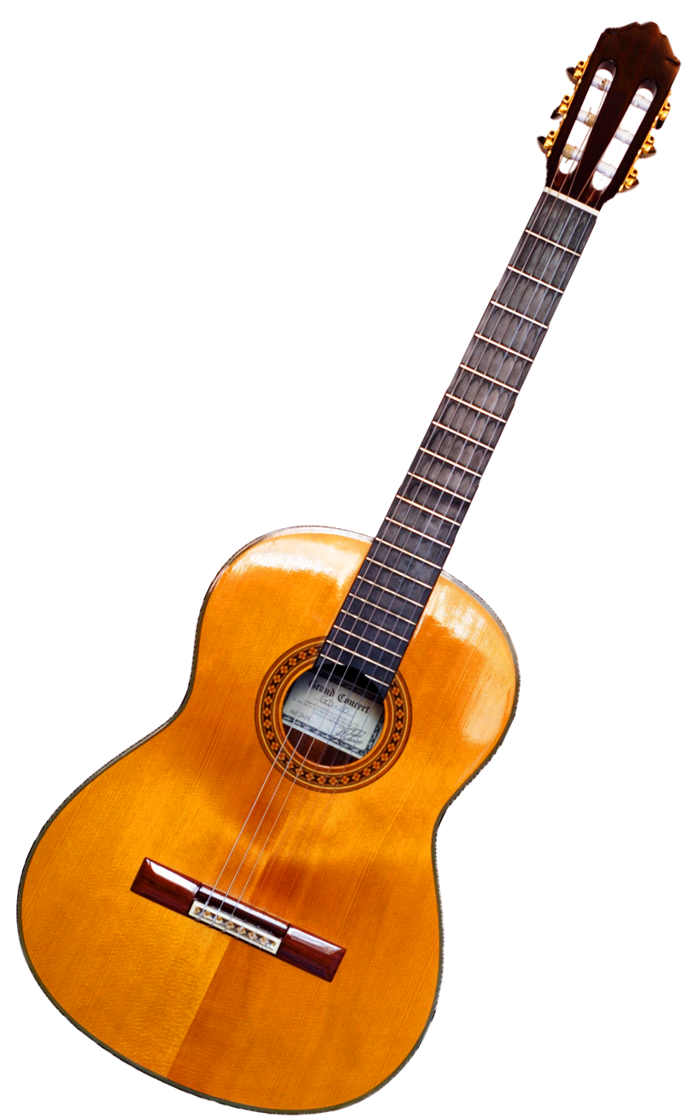
Guitar learning software

Slide 3
MUSIC SKILLS:
Brain growth
Studies in neuroscience show that music can enhance brain function in children. Musical activities (such as playing an instrument, singing or just listening to music) stimulate the brain, and this brain workout leads to improved brain structure with the formation of new neural connections.
Language skills
Studies also show that young children who participate in music classes have improved speech development and learn to read more easily. Learning music helps to develop the left side of the brain (related to language and reasoning), assists with sound recognition, and teaches rhythm and rhyme. Songs can also help children remember information (just think of the Alphabet song!).
Maths skills
Music can help with the development of maths skills. By listening to musical beats your child can learn basic fractions, pattern-recognition and problem solving. Children who study music also have improved spatial intelligence and ability to form mental pictures of objects – skills that are important for more advanced mathematics.

Slide 4
Memory, attention and concentration
Recent studies have shown that people who are musically trained have better working memory skills, helping them to remember things even while their minds are busy with other matters – important aspects of mental arithmetic and reading comprehension. Learning music also requires significant levels of concentration, training children to focus their attention for sustained periods.
Achievement and discipline
Learning music teaches children to work towards short-term goals, develop routine and practice self-discipline. Setting aside regular time for practice develops commitment and patience. Mastering a new piece of music leads to a sense of pride and achievement, and helps children to learn the value of self-discipline.
Social skills
Making music with other people (like in a band or choir) improves children’s social and emotional skills. They learn to work together as a team and develop their sense of empathy with others. Researchers have found that when children play music together – from simple rhythms to larger group performances – they are better able to tune into other people’s emotions.

Slide 5
How visual learning will help students.
Various concepts have been introduced to improve students’ analytical thinking skills based on problem based
This project introduces a concept to increase student’s analytical thinking skills based on a visual learning.
visual learning strategy. Such a strategy has three fundamental components: a teacher, a student, and a learning process.

Slide 6
Use of this software:
This is a software which will help in learning guitar.it has structures of chords and basic information about guitar learning.
It's very user friendly to use.
Visual images will help in learning the chords.

Slide 7
Why this software:
To make software which will help students to learn guitar by visual.
● It will help in learning guitar chords.
● It will give students information about guitar

Slide 8
What is guitar chords
in music, a guitar chord is a set of notes played on a guitar. A chord's notes are often played simultaneously, but they can be played sequentially in an arpeggio.
The implementation of guitar chords depends on the guitar tuning. Most guitars used in popular music have six strings with the "standard" tuning of the Spanish classical guitar, namely E–A–D–G–B–E' (from the lowest pitched string to the highest); in standard tuning.
the intervals present among adjacent strings are perfect fourths except for the major third (G,B). Standard tuning requires four chord-shapes for the major triads.

Slide 9
Strings
Fretboard and frets
G. Body

Slide 10
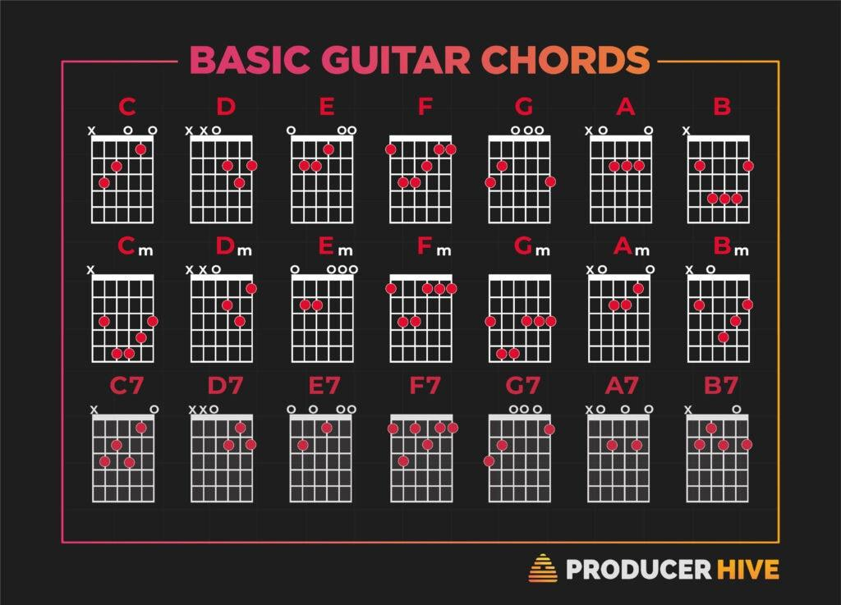
Chords:

Slide 11

FRAME 1:
FRAME 1:
GIVES TWO OPTIONS
1.TO LEARN ABOUT GUITAR
2.TO LEARN ABOUT CHORDS

Slide 12
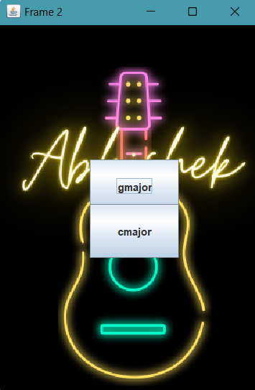
FARME 2:
FRAME 2:
IT ALSO GIVE TWO OPTIONS:
TO LEARN G-MAJOR CHORD.
TO LEARN ABOUT C-MAJOR CHORD.

Slide 13
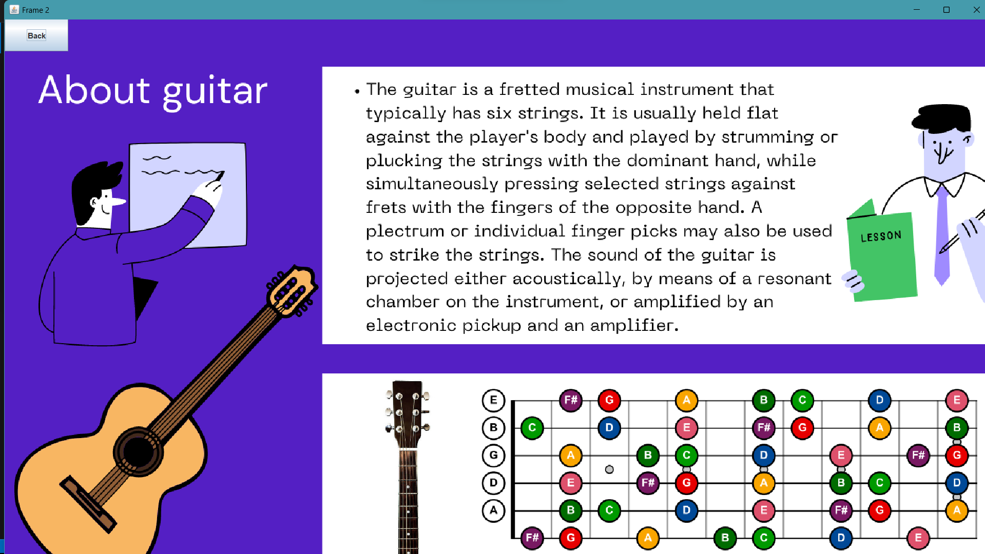
FRAME 3.
THIS FRAME WILL BE OPENED WHEN YOU PRESS BUTTON ABOUT GUITAR.
IT WILL GIVE INFORMATION ABOUT GUITAR WORKING

Slide 14
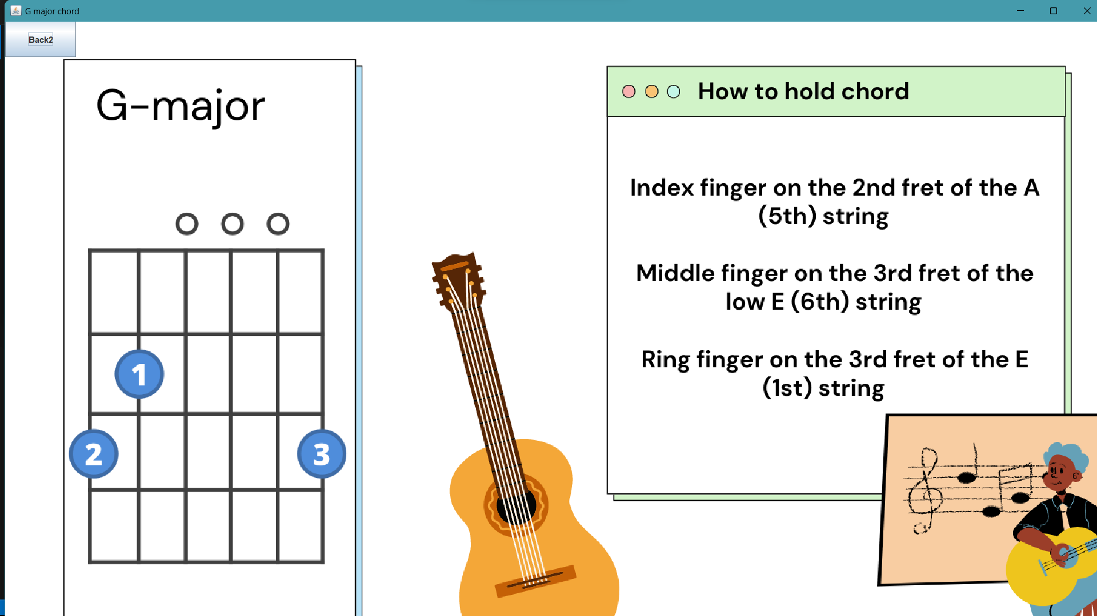
G-MAJOR CHORD FRAME:
THIS WILL BE OPEN WHEN YOU CLICK ON G-MAJOR BUTTON.
THIS WILL SHOW THE INFORMATION ABOUT THE G-MAJOR CHORD.

Slide 15
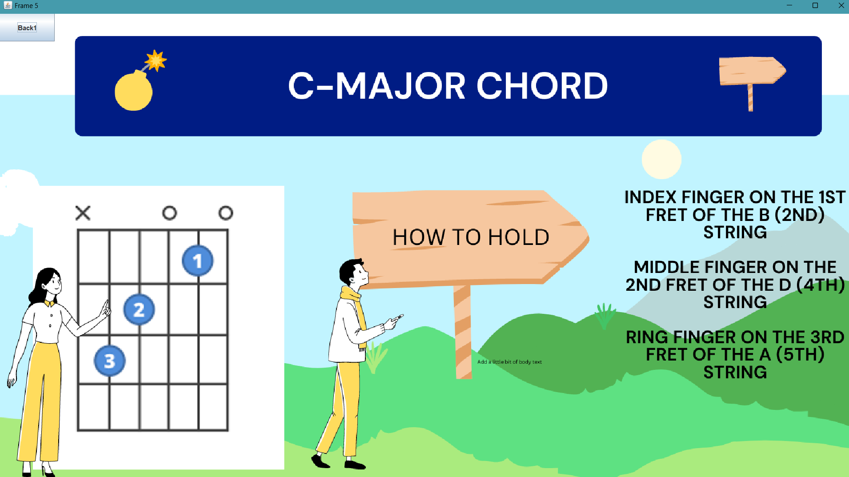
C-MAJOR
THIS WILL SHOW INFORMATION ABOUT C-MAJOR CHORD.
THIS WILL OPEN WHEN YOU CLICK ON C-MAJOR BUTTON.
IT CONTAIN BACK BUTTON TO GO BACK TAB.

Slide 16
Conclusion:
Learning by visuals increases learning speed.This software can help students to learn and take knowledge about guitar and its basics.

Slide 17
Future scope:
Adding more media files like sound of chord.
Adding more chords.
Adding machine learning models for sound check.

Slide 18
Thank you

